Slide 1

Natural Language Processing (NLP)

Slide 2


List Of Contents
Introduction to NLP
Why NLP is need
Applications of NLP
Basics of Tokenization
Stemming
Lemmatization
4
7. Dicussion,Conclusion and Refrences

Slide 3
What is NLP?
Natural Language Processing (NLP) is a field of CS and AI focused on enabling computers to understand, interpret, and generate human language.
Overcoming the gap between human communication and machine understanding…
7. Dicussion,Conclusion and Refrences

Slide 4

Why we need NLP?
By this technique, we convert textual data into numbers. Because, computers don’t understand texts otherwise…
4
7. Dicussion,Conclusion and Refrences

Slide 5
Applications of NLP:
Contest based recommendation systems
Sentimental Analysis
Language Translation
Speech Recognition
And many more…
4
7. Dicussion,Conclusion and Refrences

Slide 6
Steps in NLP?
Preprocessing:
Tokenization
Stemming/Lemmatization
Remove Stop words
Convert to numeric form:
Tfidf
Count Vectorizer
4
7. Dicussion,Conclusion and Refrences

Slide 7
1-Tokenization
Tokenization is the process of breaking down a piece of text into smaller, manageable units called tokens.
Note: words, phrases, sentences, or even individual characters can be tokens
4
7. Dicussion,Conclusion and Refrences

Slide 8
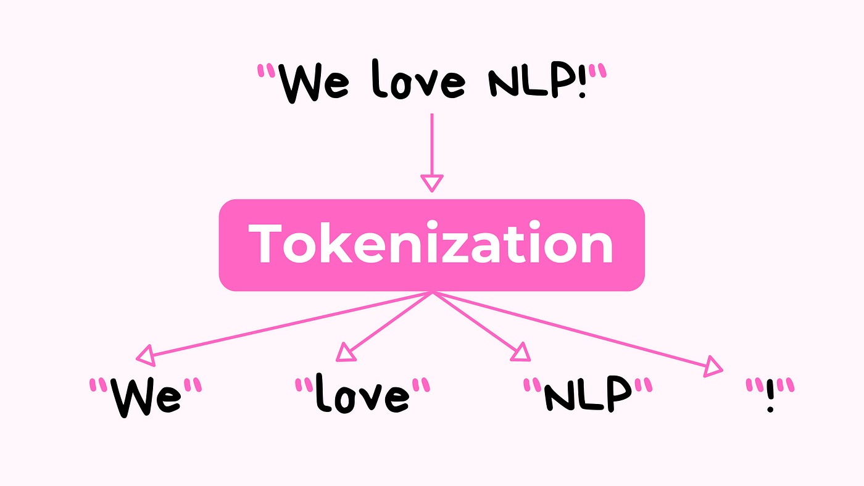

Slide 9
Types of Tokenization
Word level tokens
Sentence level tokens
Character level tokens
4
7. Dicussion,Conclusion and Refrences

Slide 10
2- Stemming
Reduces words to their root or base form by removing prefixes or suffixes.
Often results in non-dictionary words (e.g., "running" → "run" or "runn")
4
7. Dicussion,Conclusion and Refrences

Slide 11
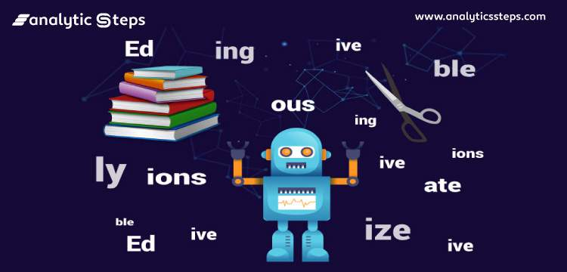

Slide 12
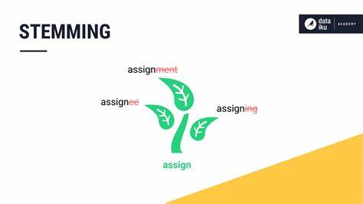

Slide 13
from nltk.stem import PorterStemmer
Low accuracy compared to lemmatization
Stemming may produce invalid word
4
7. Dicussion,Conclusion and Refrences

Slide 14
Lemmatization?
Lemmatization is the process of reducing a word to its base or dictionary form, while considering the context and part of speech (POS).
Unlike stemming, lemmatization always produces valid dictionary words.
7. Dicussion,Conclusion and Refrences

Slide 15
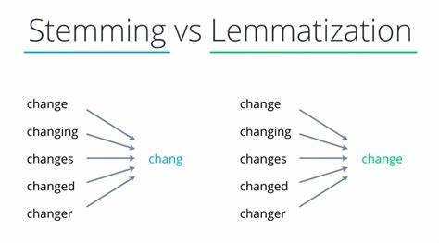
7. Dicussion,Conclusion and Refrences

Slide 16
How Lemmatization works?
from nltk.stem import WordNetLemmatizer
Tokenize word
name= WordNetLemmatizer()
Name.lemmatize(word)
7. Dicussion,Conclusion and Refrences

Slide 17
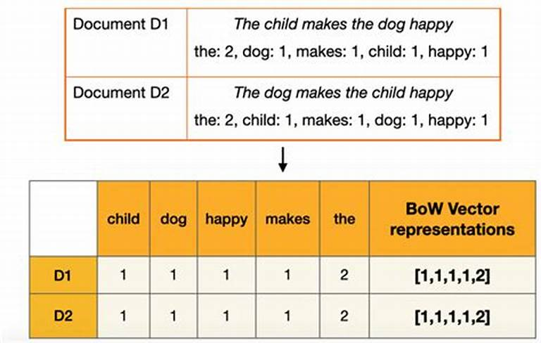
7. Dicussion,Conclusion and Refrences

